Slide 1
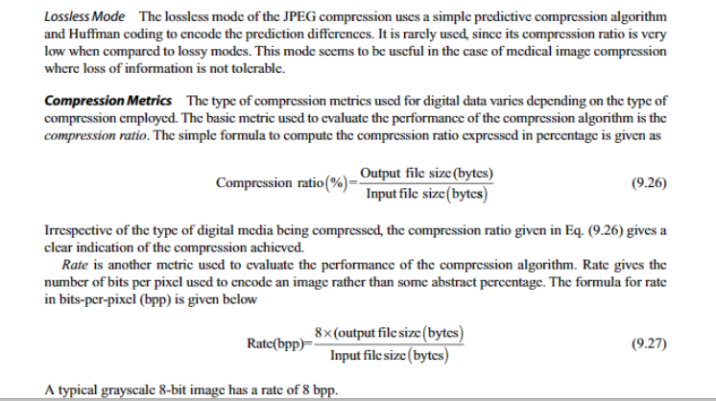

Slide 2
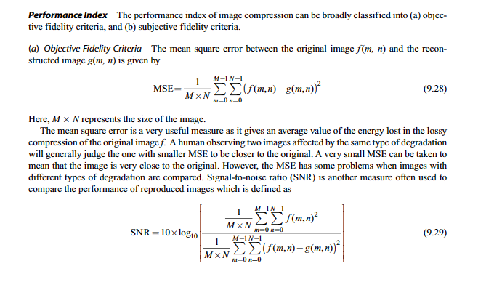

Slide 3
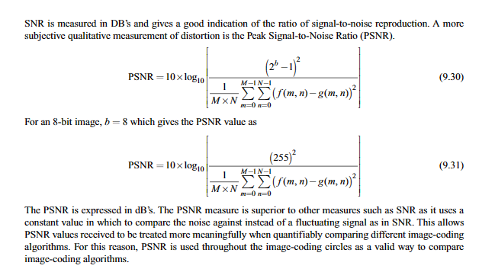

Slide 4
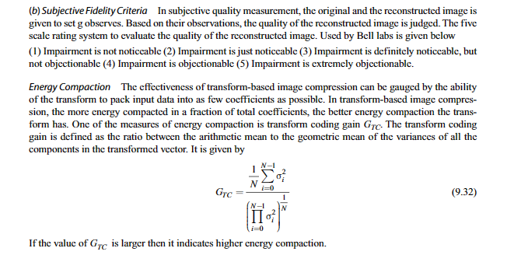

Slide 5

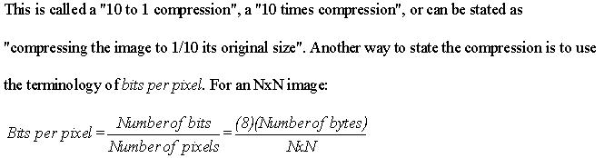
The compression ratio is denoted by:
(c) Scott E Umbaugh, SIUE 2005

Slide 6
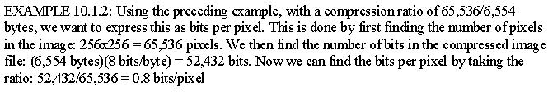
The reduction in file size is necessary to meet the bandwidth requirements for many transmission systems, and for the storage requirements in computer databases
Also, the amount of data required for digital images is enormous
(c) Scott E Umbaugh, SIUE 2005

Slide 7
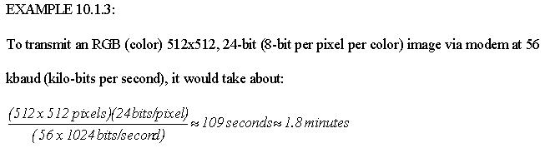
This number is based on the actual transmission rate being the maximum, which is typically not the case due to Internet traffic, overhead bits and transmission errors
(c) Scott E Umbaugh, SIUE 2005

Slide 8
Additionally, considering that a web page might contain more than one of these images, the time it takes is simply too long
For high quality images the required resolution can be much higher than the previous example
(c) Scott E Umbaugh, SIUE 2005

Slide 9
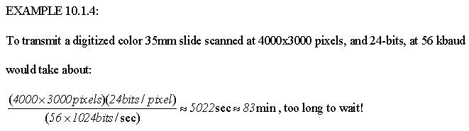
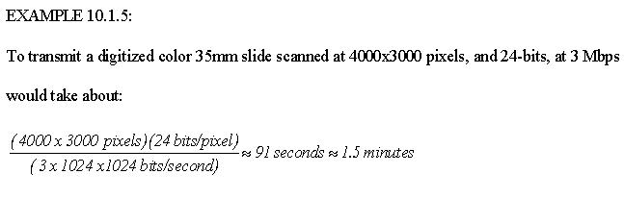
Example 10.1.5 applies maximum data rate to Example 10.1.4
(c) Scott E Umbaugh, SIUE 2005

Slide 10
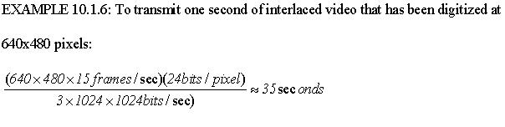
Now, consider the transmission of video images, where we need multiple frames per second
If we consider just one second of video data that has been digitized at 640x480 pixels per frame, and requiring 15 frames per second for interlaced video, then:
(c) Scott E Umbaugh, SIUE 2005

Slide 11
Waiting 35 seconds for one second’s worth of video is not exactly real time!
Even attempting to transmit uncompressed video over the highest speed Internet connection is impractical
For example: The Japanese Advanced Earth Observing Satellite (ADEOS) transmits image data at the rate of 120 Mbps
(c) Scott E Umbaugh, SIUE 2005

Slide 12
Applications requiring high speed connections such as high definition television, real-time teleconferencing, and transmission of multiband high resolution satellite images, leads us to the conclusion that image compression is not only desirable but necessessary
Key to a successful compression scheme is retaining necessary information
(c) Scott E Umbaugh, SIUE 2005

Slide 13
To understand “retaining necessary information”, we must differentiate between data and information
Data:
For digital images, data refers to the pixel gray level values that correspond to the brightness of a pixel at a point in space
Data are used to convey information, much like the way the alphabet is used to convey information via words
(c) Scott E Umbaugh, SIUE 2005

Slide 14
Information:
Information is an interpretation of the data in a meaningful way
Information is an elusive concept; it can be application specific
(c) Scott E Umbaugh, SIUE 2005

Slide 15
There are two primary types of image compression methods:
Lossless compression methods:
Allows for the exact recreation of the original image data, and can compress complex images to a maximum 1/2 to 1/3 the original size – 2:1 to 3:1 compression ratios
Preserves the data exactly
(c) Scott E Umbaugh, SIUE 2005

Slide 16
Lossy compression methods:
Data loss, original image cannot be re-created exactly
Can compress complex images 10:1 to 50:1 and retain high quality, and 100 to 200 times for lower quality, but acceptable, images
(c) Scott E Umbaugh, SIUE 2005

Slide 17
Compression algorithms are developed by taking advantage of the redundancy that is inherent in image data
Four primary types of redundancy that can be found in images are:
Coding
Interpixel
Interband
Psychovisual redundancy
(c) Scott E Umbaugh, SIUE 2005

Slide 18
Coding redundancy
Occurs when the data used to represent the image is not utilized in an optimal manner
Interpixel redundancy
Occurs because adjacent pixels tend to be highly correlated, in most images the brightness levels do not change rapidly, but change gradually
(c) Scott E Umbaugh, SIUE 2005

Slide 19
Interband redundancy
Occurs in color images due to the correlation between bands within an image – if we extract the red, green and blue bands they look similar
Psychovisual redundancy
Some information is more important to the human visual system than other types of information
(c) Scott E Umbaugh, SIUE 2005

Slide 20
The key in image compression algorithm development is to determine the minimal data required to retain the necessary information
The compression is achieved by taking advantage of the redundancy that exists in images
If the redundancies are removed prior to compression, for example with a decorrelation process, a more effective compression can be achieved
(c) Scott E Umbaugh, SIUE 2005

Slide 21
To help determine which information can be removed and which information is important, the image fidelity criteria are used
These measures provide metrics for determining image quality
It should be noted that the information required is application specific, and that, with lossless schemes, there is no need for a fidelity criteria
(c) Scott E Umbaugh, SIUE 2005

Slide 22
Compression System Model
The compression system model consists of two parts:
The compressor
The decompressor
The compressor consists of a preprocessing stage and encoding stage, whereas the decompressor consists of a decoding stage followed by a postprocessing stage
(c) Scott E Umbaugh, SIUE 2005

Slide 23
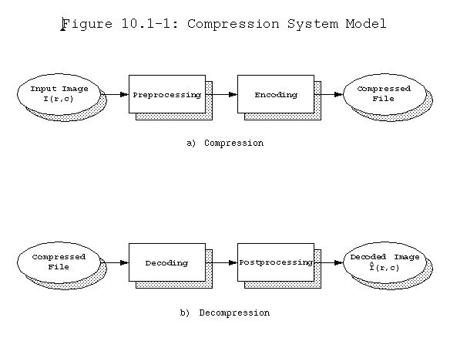
Decompressed image
(c) Scott E Umbaugh, SIUE 2005

Slide 24
Before encoding, preprocessing is performed to prepare the image for the encoding process, and consists of any number of operations that are application specific
After the compressed file has been decoded, postprocessing can be performed to eliminate some of the potentially undesirable artifacts brought about by the compression process
(c) Scott E Umbaugh, SIUE 2005

Slide 25
The compressor can be broken into following stages:
Data reduction: Image data can be reduced by gray level and/or spatial quantization, or can undergo any desired image improvement (for example, noise removal) process
Mapping: Involves mapping the original image data into another mathematical space where it is easier to compress the data
(c) Scott E Umbaugh, SIUE 2005

Slide 26
Quantization: Involves taking potentially continuous data from the mapping stage and putting it in discrete form
Coding: Involves mapping the discrete data from the quantizer onto a code in an optimal manner
A compression algorithm may consist of all the stages, or it may consist of only one or two of the stages
(c) Scott E Umbaugh, SIUE 2005

Slide 27
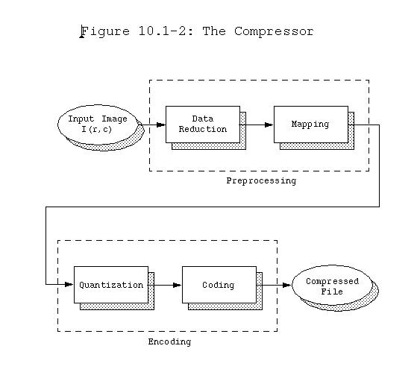
(c) Scott E Umbaugh, SIUE 2005

Slide 28
The decompressor can be broken down into following stages:
Decoding: Takes the compressed file and reverses the original coding by mapping the codes to the original, quantized values
Inverse mapping: Involves reversing the original mapping process
(c) Scott E Umbaugh, SIUE 2005

Slide 29
Postprocessing: Involves enhancing the look of the final image
This may be done to reverse any preprocessing, for example, enlarging an image that was shrunk in the data reduction process
In other cases the postprocessing may be used to simply enhance the image to ameliorate any artifacts from the compression process itself
(c) Scott E Umbaugh, SIUE 2005

Slide 30
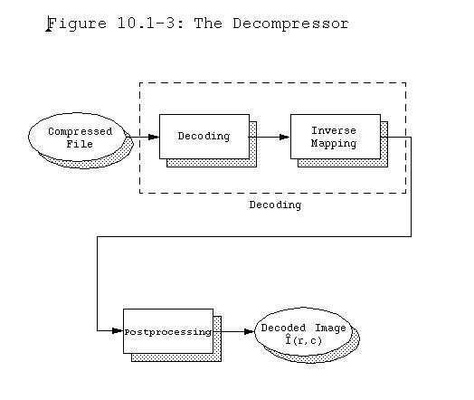
Decompressed image
(c) Scott E Umbaugh, SIUE 2005

Slide 31
The development of a compression algorithm is highly application specific
Preprocessing stage of compression consists of processes such as enhancement, noise removal, or quantization are applied
The goal of preprocessing is to prepare the image for the encoding process by eliminating any irrelevant information, where irrelevant is defined by the application
(c) Scott E Umbaugh, SIUE 2005

Slide 32
For example, many images that are for viewing purposes only can be preprocessed by eliminating the lower bit planes, without losing any useful information
(c) Scott E Umbaugh, SIUE 2005

Slide 33
The mapping process is important because image data tends to be highly correlated
Specifically, if the value of one pixel is known, it is highly likely that the adjacent pixel value is similar
By finding a mapping equation that decorrelates the data this type of data redundancy can be removed
(c) Scott E Umbaugh, SIUE 2005

Slide 34
Differential coding: Method of reducing data redundancy, by finding the difference between adjacent pixels and encoding those values
The principal components transform can also be used, which provides a theoretically optimal decorrelation
Color transforms are used to decorrelate data between image bands
(c) Scott E Umbaugh, SIUE 2005

Slide 35
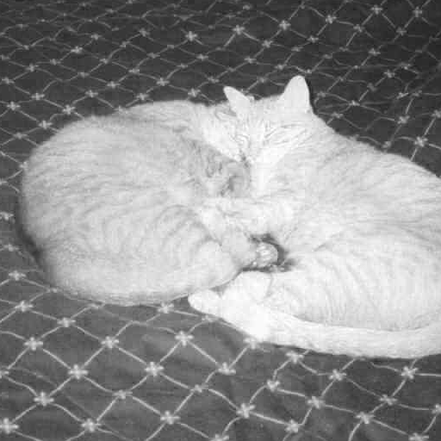

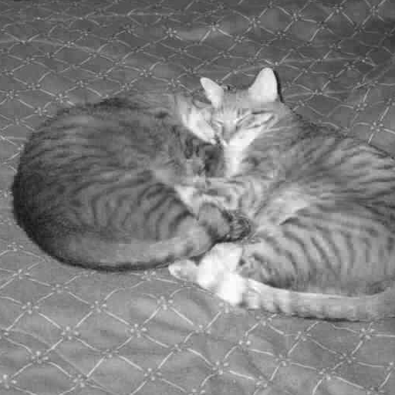



Figure -5.6.1 Principal Components Transform (PCT)
a) Red band of a color image
b) Green band
c) Blue band
d) Principal component band 1
e) Principal component band 2
f) Principal component band 3
(c) Scott E Umbaugh, SIUE 2005

Slide 36
As the spectral domain can also be used for image compression, so the first stage may include mapping into the frequency or sequency domain where the energy in the image is compacted into primarily the lower frequency/sequency components
These methods are all reversible, that is information preserving, although all mapping methods are not reversible
(c) Scott E Umbaugh, SIUE 2005

Slide 37
Quantization may be necessary to convert the data into digital form (BYTE data type), depending on the mapping equation used
This is because many of these mapping methods will result in floating point data which requires multiple bytes for representation which is not very efficient, if the goal is data reduction
(c) Scott E Umbaugh, SIUE 2005

Slide 38
Quantization can be performed in the following ways:
Uniform quantization: In it, all the quanta, or subdivisions into which the range is divided, are of equal width
Nonuniform quantization: In it the quantization bins are not all of equal width
(c) Scott E Umbaugh, SIUE 2005

Slide 39
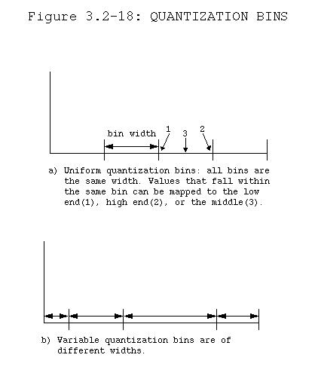
(c) Scott E Umbaugh, SIUE 2005

Slide 40
Often, nonuniform quantization bins are designed to take advantage of the response of the human visual system
In the spectral domain, the higher frequencies may also be quantized with wider bins because we are more sensitive to lower and midrange spatial frequencies and most images have little energy at high frequencies
(c) Scott E Umbaugh, SIUE 2005

Slide 41
The concept of nonuniform quantization bin sizes is also described as a variable bit rate, since the wider quantization bins imply fewer bits to encode, while the smaller bins need more bits
It is important to note that the quantization process is not reversible, so it is not in the decompression model and also some information may be lost during quantization
(c) Scott E Umbaugh, SIUE 2005

Slide 42
The coder in the coding stage provides a one-to-one mapping, each input is mapped to a unique output by the coder, so it is a reversible process
The code can be an equal length code, where all the code words are the same size, or an unequal length code with variable length code words
(c) Scott E Umbaugh, SIUE 2005

Slide 43
In most cases, an unequal length code is the most efficient for data compression, but requires more overhead in the coding and decoding stages
(c) Scott E Umbaugh, SIUE 2005

Slide 44
Block Truncation Coding
Block truncation coding (BTC) works by dividing the image into small subimages and then reducing the number of gray levels within each block
The gray levels are reduced by a quantizer that adapts to local statistics
(c) Scott E Umbaugh, SIUE 2005

Slide 45
The levels for the quantizer are chosen to minimize a specified error criteria, and then all the pixel values within each block are mapped to the quantized levels
The necessary information to decompress the image is then encoded and stored
The basic form of BTC divides the image into N * N blocks and codes each block using a two-level quantizer
(c) Scott E Umbaugh, SIUE 2005

Slide 46
The two levels are selected so that the mean and variance of the gray levels within the block are preserved
Each pixel value within the block is then compared with a threshold, typically the block mean, and then is assigned to one of the two levels
If it is above the mean it is assigned the high level code, if it is below the mean, it is assigned the low level code
(c) Scott E Umbaugh, SIUE 2005

Slide 47
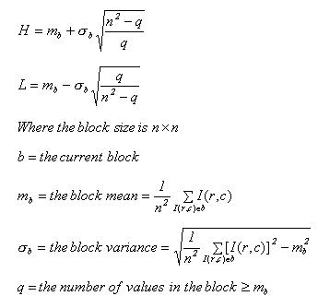
If we call the high value H and the low value L, we can find these values via the following equations:
(c) Scott E Umbaugh, SIUE 2005

Slide 48
If n = 4, then after the H and L values are found, the 4x4 block is encoded with four bytes
Two bytes to store the two levels, H and L, and two bytes to store a bit string of 1's and 0's corresponding to the high and low codes for that particular block
(c) Scott E Umbaugh, SIUE 2005

Slide 49
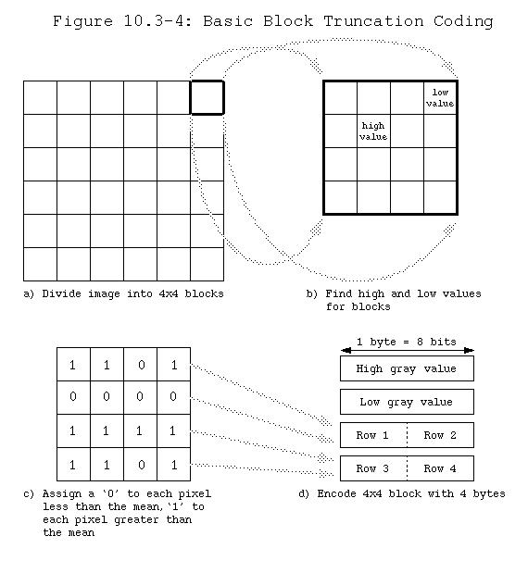
(c) Scott E Umbaugh, SIUE 2005

Slide 50
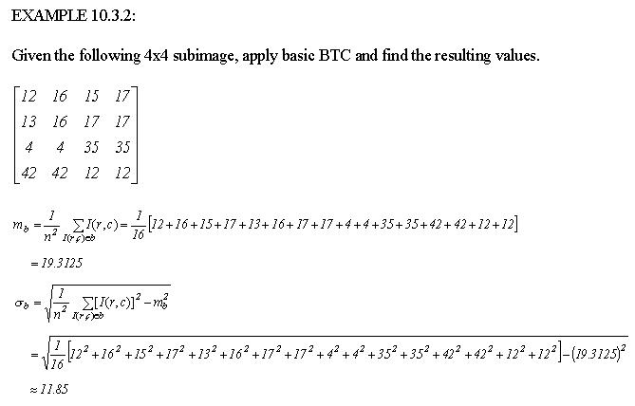
(c) Scott E Umbaugh, SIUE 2005

Slide 51
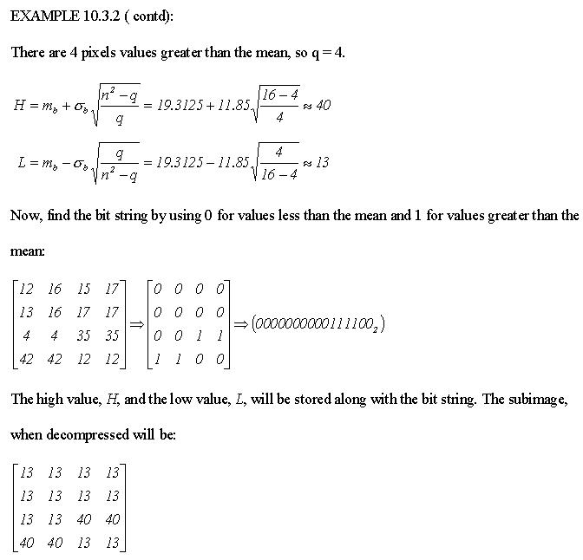
(c) Scott E Umbaugh, SIUE 2005

Slide 52
This algorithm tends to produce images with blocky effects
These artifacts can be smoothed by applying enhancement techniques such as median and average (lowpass) filters
(c) Scott E Umbaugh, SIUE 2005

Slide 53
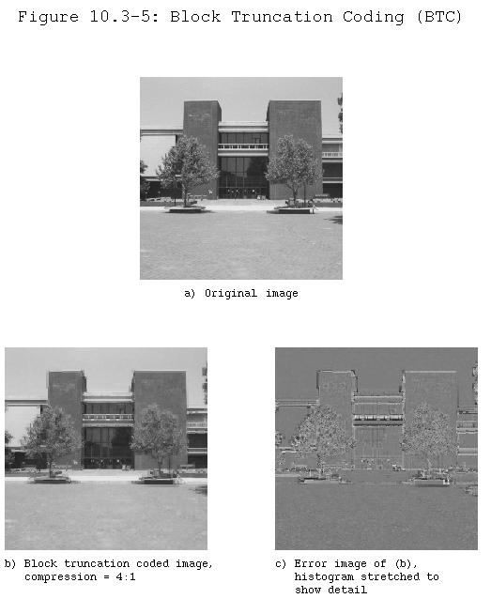
(c) Scott E Umbaugh, SIUE 2005

Slide 54
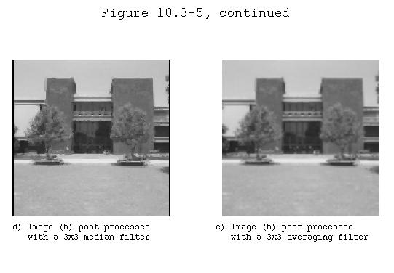
(c) Scott E Umbaugh, SIUE 2005

Slide 55
The multilevel BTC algorithm, which uses a 4-level quantizer, allows for varying the block size, and a larger block size should provide higher compression, but with a corresponding decrease in image quality
With this particular implementation, we get decreasing image quality, but the compression ratio is fixed
(c) Scott E Umbaugh, SIUE 2005

Slide 56
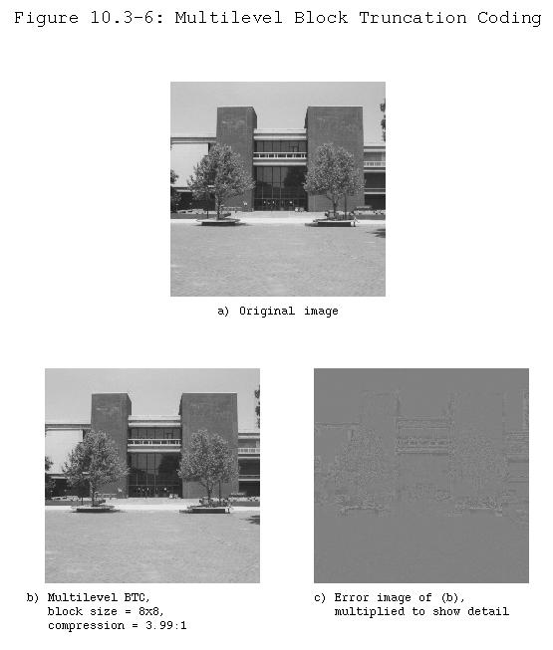
(c) Scott E Umbaugh, SIUE 2005

Slide 57
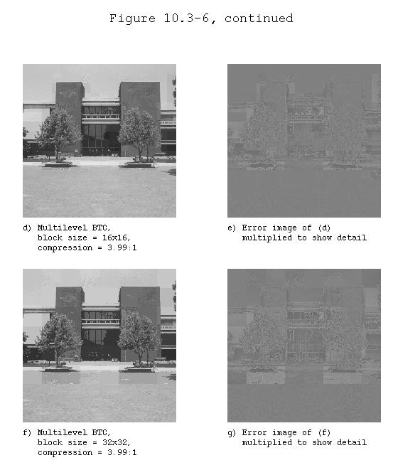
(c) Scott E Umbaugh, SIUE 2005

Slide 58
Vector Quantization
Vector quantization (VQ) is the process of mapping a vector that can have many values to a vector that has a smaller (quantized) number of values
For image compression, the vector corresponds to a small subimage, or block
(c) Scott E Umbaugh, SIUE 2005

Slide 59
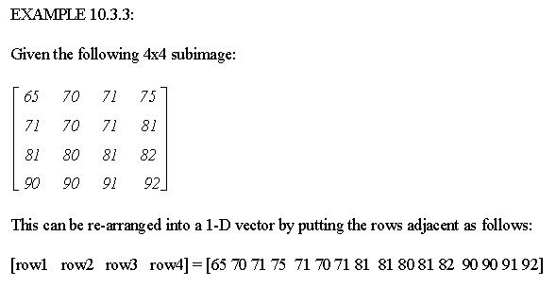
(c) Scott E Umbaugh, SIUE 2005

Slide 60
VQ can be applied in both the spectral or spatial domains
Information theory tells us that better compression can be achieved with vector quantization than with scalar quantization (rounding or truncating individual values)
(c) Scott E Umbaugh, SIUE 2005

Slide 61
Vector quantization treats the entire subimage (vector) as a single entity and quantizes it by reducing the total number of bits required to represent the subimage
This is done by utilizing a codebook, which stores a fixed set of vectors, and then coding the subimage by using the index (address) into the codebook
(c) Scott E Umbaugh, SIUE 2005

Slide 62
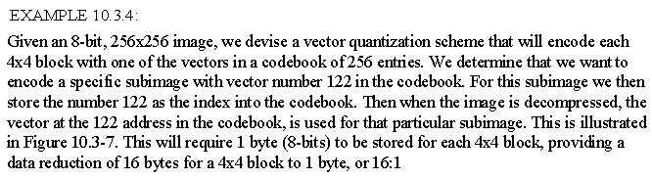
In the example we achieved a 16:1 compression, but note that this assumes that the codebook is not stored with the compressed file
(c) Scott E Umbaugh, SIUE 2005

Slide 63
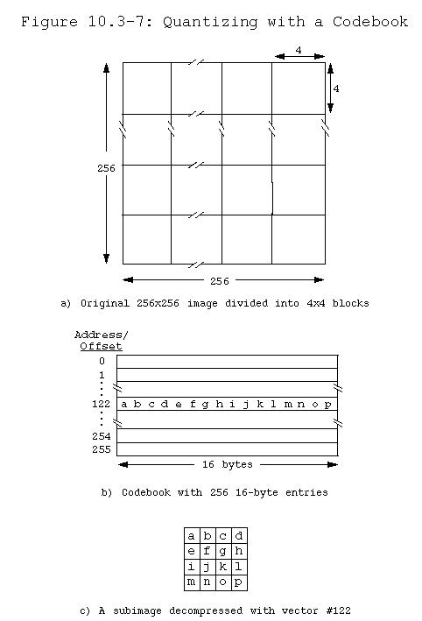
(c) Scott E Umbaugh, SIUE 2005

Slide 64
However, the codebook will need to be stored unless a generic codebook is devised which could be used for a particular type of image, in that case we need only store the name of that particular codebook file
In the general case, better results will be obtained with a codebook that is designed for a particular image
(c) Scott E Umbaugh, SIUE 2005

Slide 65
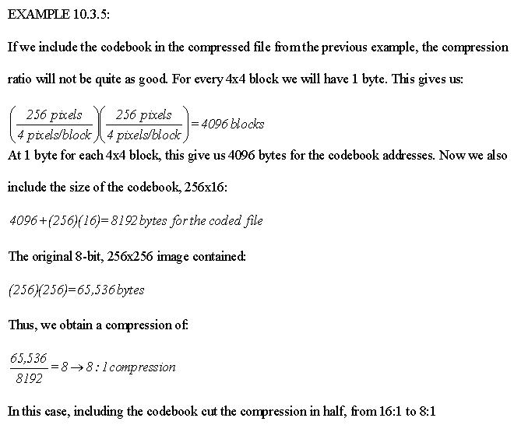
(c) Scott E Umbaugh, SIUE 2005

Slide 66
A training algorithm determines which vectors will be stored in the codebook by finding a set of vectors that best represent the blocks in the image
This set of vectors is determined by optimizing some error criterion, where the error is defined as the sum of the vector distances between the original subimages and the resulting decompressed subimages
(c) Scott E Umbaugh, SIUE 2005

Slide 67
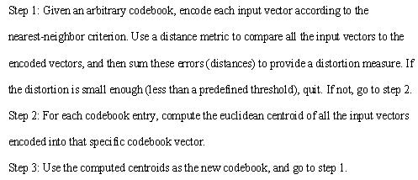
The standard algorithm to generate the codebook is the Linde-Buzo-Gray (LBG) algorithm, also called the K-means or the clustering algorithm:
(c) Scott E Umbaugh, SIUE 2005

Slide 68
The LBG algorithm, along with other iterative codebook design algorithms do not, in general, yield globally optimum codes
These algorithms will converge to a local minimum in the error (distortion) space
Theoretically, to improve the codebook, the algorithm is repeated with different initial random codebooks and the one codebook that minimizes distortion is chosen
(c) Scott E Umbaugh, SIUE 2005

Slide 69
However, the LBG algorithm will typically yield "good" codes if the initial codebook is carefully chosen by subdividing the vector space and finding the centroid for the sample vectors within each division
These centroids are then used as the initial codebook
Alternately, a subset of the training vectors, preferably spread across the vector space, can be randomly selected and used to initialize the codebook
(c) Scott E Umbaugh, SIUE 2005

Slide 70
The primary advantage of vector quantization is simple and fast decompression, but with the high cost of complex compression
The decompression process requires the use of the codebook to recreate the image, which can be easily implemented with a look-up table (LUT)
(c) Scott E Umbaugh, SIUE 2005

Slide 71
This type of compression is useful for applications where the images are compressed once and decompressed many times, such as images on an Internet site
However, it cannot be used for real-time applications
(c) Scott E Umbaugh, SIUE 2005

Slide 72


Figure 10.3-8
Vector Quantization in the Spatial Domain
a) Original image
b) VQ with 4x4 vectors, and a
codebook of 128 entries,
compression ratio = 11.49
(c) Scott E Umbaugh, SIUE 2005

Slide 73


Figure 10.3-8
Vector Quantization in the Spatial Domain (contd)
c) VQ with 4x4 vectors, and a
codebook of 256 entries,
compression ratio = 7.93
d) VQ with 4x4 vectors, and a
codebook of 512 entries,
compression ratio = 5.09
Note: As the codebook size is increased the image quality improves and the
compression ratio decreases
(c) Scott E Umbaugh, SIUE 2005

Slide 74
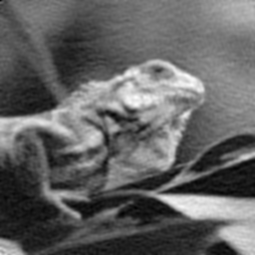

Figure 10.3-9
Vector Quantization in the Transform Domain
Note: The original image is the image in Figure 10.3-8a
a) VQ with the discrete cosine transform,
compression ratio = 9.21
b) VQ with the wavelet transform,
compression ratio = 9.21
(c) Scott E Umbaugh, SIUE 2005

Slide 75


Figure 10.3-9
Vector Quantization in the Transform Domain (contd)
c) VQ with the discrete cosine transform,
compression ratio = 3.44
d) VQ with the wavelet transform,
compression ratio = 3.44
(c) Scott E Umbaugh, SIUE 2005

